Slide 1
Exome Sequencing Data Analysis
Chunhua Yan, Ph.D.
NCI Center for Biomedical Informatics and Information Technology (CBIIT)
3/18/2015

Slide 2
Exome sequencing workflow
Sample preparation
Genomic DNA
Library construction
Sequencing
Illumina, Roche, Life Tech.
Raw reads
FASTQ, QC report
Bwa-Mem, Novoalign, SAMtools
Mapped reads
Bam files, Alignment stats
MuTect, VarScan, GATK
Possible mutations and indels
ANNOVAR, MutSig, HotNet, MEMo
Annotated and filtered functional variants
Manual review, Target re-sequencing
Confirmed novel functional variants

Slide 3
Next generation sequencing (NGS)
Platform
Productivity
Exome sequencing
Experimental design
Mutation study resources

Slide 4
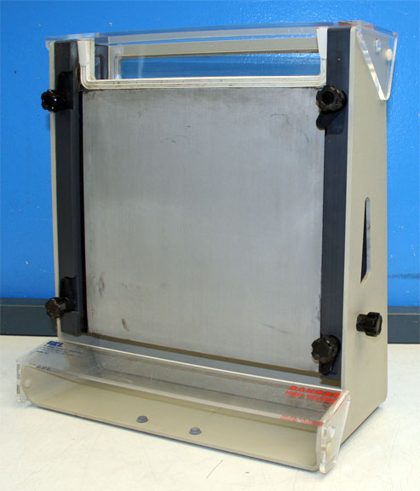

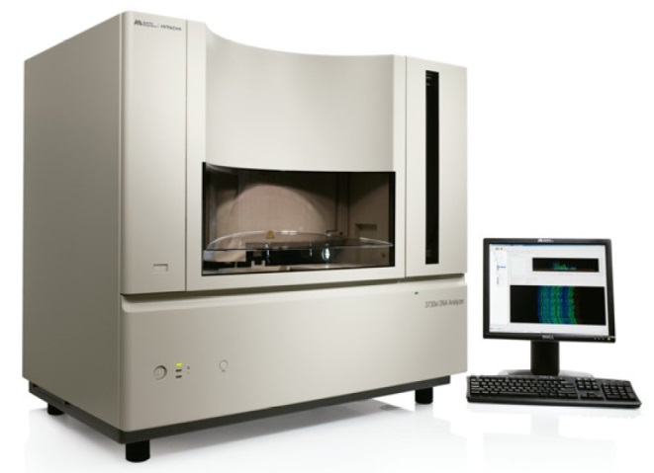
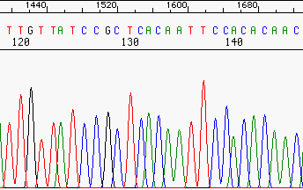
Sanger sequencing was the 20th century technology

Slide 5



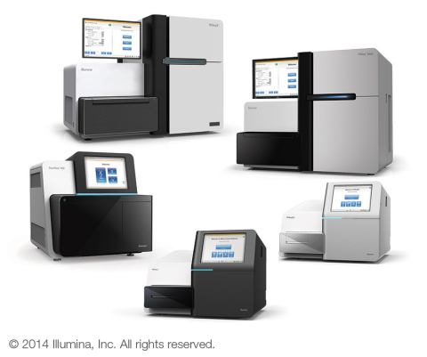
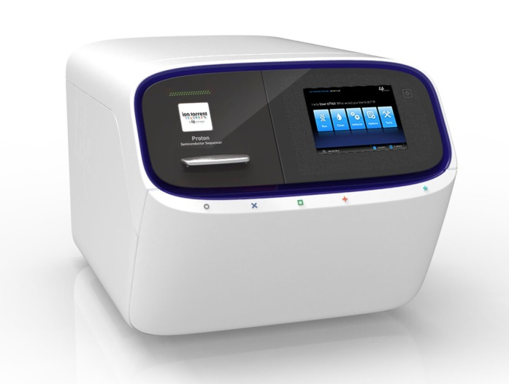
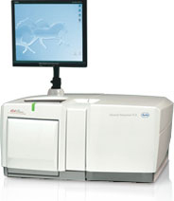
Next generation sequencing technology is just a decade old
Notes:
Miseq: 25M reads X 300bp, 15gb, 1 -2 days.
NextSeq: 400M reads X 150bp, 120gb, 1 day
HiSeq: 2B reads X50bp, 1,5T, 1-4 days,
Ion proton: Chip-based semiconductor sequencing enables you to scale your runs to your research needs. The Ion PI™ Chip provides you with 40–80 M reads, enabling you to sequence 1–3 human exomes or 1–8 human transcriptomes per run.
Ion PI™ Chip 2–4 hr Up to 10 Gb
Roche 454: Pyrosequencing reaction of 454 Sequencing Systems. Millions of copies of a single clonal fragment are contained on each DNA Capture Bead.
Sequencing Kit New! GS FLX Titanium XL+ GS FLX Titanium XLR70 Read Length Up to 1,000 bp Up to 600 bp Mode Read Length 700 bp 450 bp Throughput Profile - 85% of total bases from reads >500 bp - 45% of total bases from reads >700 bp - 85% of total bases from reads > 300 bp - 20% of total bases from reads > 500 bp
Typical Throughput 700 Mb 450 Mb
Reads per Run ~1,000,000 shotgun ~1,000,000 shotgun, ~700,000 amplicon
Consensus Accuracy* 99.997% 99.995% Run Time 23 hours 10 hours

Slide 6
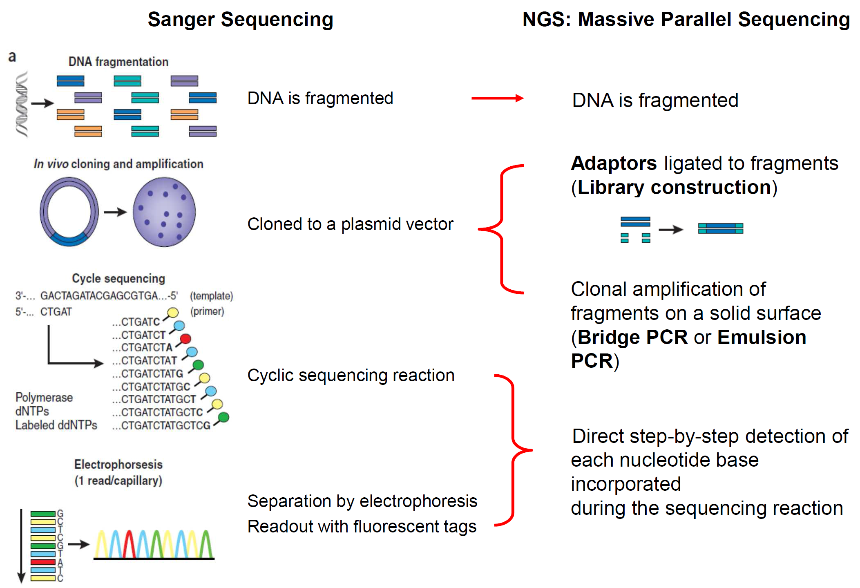
Comparison of sequencing methods
https://www.qiagen.com/us/resources/e-learning/webinars/next-generation-sequencing/

Slide 7
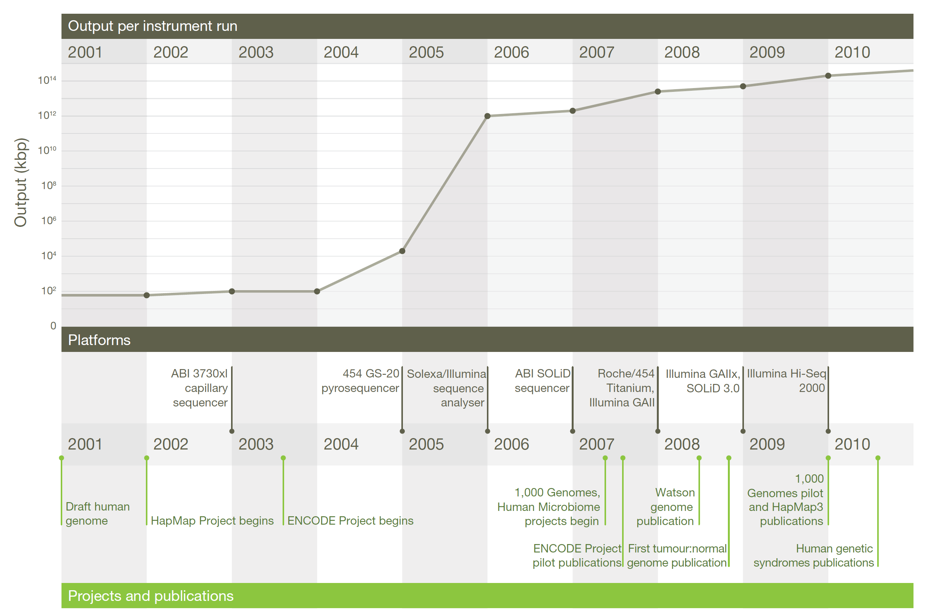
DNA sequencing – The past decade
Mardis, E.R. (2011) Nature. 470(7333):198-203. .
Notes:
http://www.sabiosciences.com/manuals/seminars/NGS%20Part%204%20Ingenuity%20Variant%20Analysis%202014.pdf

Slide 8
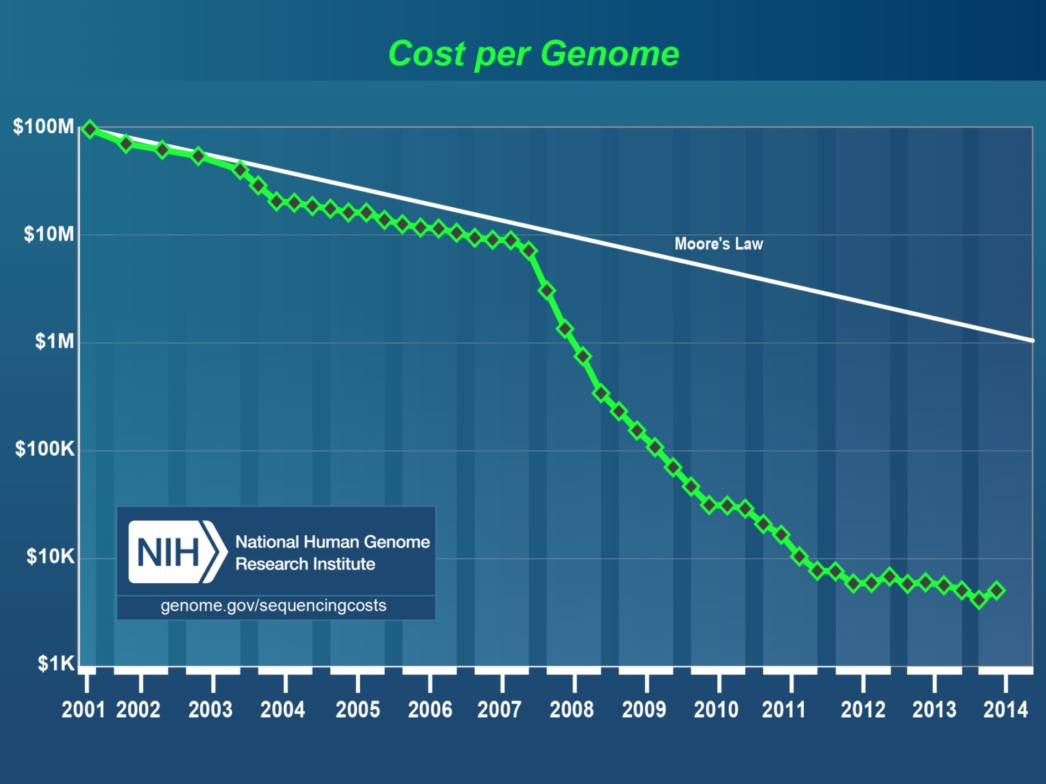
http://www.genome.gov/sequencingcosts/
Notes:
Genome Coverage
The "Cost per Genome" graph was generated using the same underlying data as that used to generate the "Cost per Megabase of DNA Sequence" graph; the former thus reflects an estimate of the cost of sequencing a human-sized genome rather than the actual costs for specific genome-sequencing projects.
To calculate the cost for sequencing a genome, one needs to know the size of that genome and the required 'sequence coverage' (i.e., 'sequence redundancy') to generate a high-quality assembly of the genome given the specific sequencing platform being used. For generating the "Cost per Genome" graph, the assumed genome size was 3,000 Mb (i.e., the size of a human genome). The assumed sequence coverage needed differed among sequencing platforms, depending on the average sequence read length for that platform.
The following 'sequence coverage' values were used in calculating the cost per genome:
Sanger-based sequencing (average read length=500-600 bases): 6-fold coverage
454 sequencing (average read length=300-400 bases): 10-fold coverage
Illumina and SOLiD sequencing (average read length=50-100 bases): 30-fold coverage
The Carlson Curve is a term coined by The Economist^{[1]} to describe the biotechnological equivalent of Moore's law, and is named after author Rob Carlson.^{[2]} Carlson predicted that the doubling time of DNA sequencing technologies (measured by cost and performance) would be at least as fast as Moore's law.^{[3]} Carlson Curves illustrate the rapid (in some cases above exponential growth) decreases in cost, and increases in performance, of a variety of technologies, including DNA sequencing, DNA synthesis and a range of physical and computational tools used in protein expression and in determining protein structures.
Moore's Law started being profoundly out-paced in January 2008 when the centers transitioned from Sanger sequencing to newer DNA sequencing technologies :^{[4]}
454 sequencing (average read length=300-400 bases): 10-fold
Illumina and SOLiD sequencing (average read length=50-100 bases): 30-fold.

Slide 9
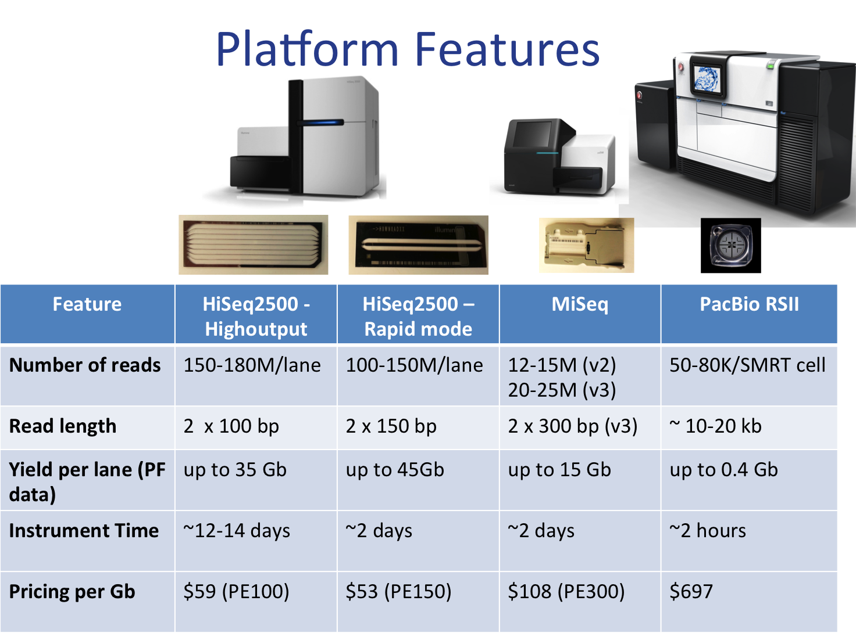
http://dnatech.genomecenter.ucdavis.edu/next-generation-sequencing/
Notes:
Our Illumina HiSeq2000 was upgraded to HiSeq2500 in June 2013. The HiSeq2500’s rapid mode combines HiSeq data output with MiSeq turnaround time. With this upgrade, we can use either 8-lane flow cell (high-output mode, ~12 days instrument time) or 2-lane flow cell (rapid mode, ~2 days instrument time). High-output mode (using 8-lane flow cell) allows up to PE100. The slow mode provides a greater number of reads and therefore is more appropriate for applications requiring tag counting such as RNAseq. Due to the short instrument time in a rapid mode, read length can be extended to PE150, available only in a rapid mode, currently as a default option. Please see table above for performance feature comparison and more details for Illumina sequencing technology
Application selected: Whole Genome Sequencing – Large
NextSeq 500
HiSeq 2500
Data Yield
20 - 120 Gb
10 - 1000 Gb
Maxiumum Read Length
2 x 150 bp
2 x 125 bp
Reads per Run
130M - 400M
300M - 4B
Run Time
12 - 30 hr
7 hr - 6 days
Price per Sample
Higher
Lower
System Price
Lower
Higher
Samples per Run*
1
1-10
* Based on 30X coverage of a human genome, assumes minimum of 100Gb per genome. Sample number will vary for other species based on relative genome size.

Slide 10
Next generation sequencing (NGS)
Exome sequencing
Benefit
Capture technology
Experimental design
Mutation study resource

Slide 11
Next Generation Sequencing Applications
Genomics
Transcript- omics
Epi- genomics
Dna-seq
RNA-seq
ChIP-Seq, Methyl-Seq
Mutation, SNVs,
Indels,
CNVs,
Translocation
Expression level
Novel transcripts
Fusion transcripts
Splice variants
Global mapping of DNA-protein interactions
DNA methylation
Histone modification

Slide 12
Whole Exome Sequencing, Why?
Focuses on the part of the genome we understand best, the exons of genes
About 85% of known mutations in Mendelian diseases affect the exome
Nonsense, missense, splice, indel mutations
Depending on the annotation and coverage of flanking sequencing: ~35-60Mb => 1-2% of human genomes
There are ~200,000 coding exons in ~20,000 genes
A whole exome is 1/6 the cost of whole genome and 1/15 the amount of data
Biesecker, L. et al. (2011) Genome Biology 12:128

Slide 13
Exome sequencing balances the coverage and cost
Sanger
Targeted
Exome
Whole Genome
Accurate
Cheap per exon
High turn‐around
Optimization possible
Low chance of incidental findings
Easy analysis
No bias for genes
Standardized workflow
Re‐use of performed exomes to interpret new ones
No sequencing bias
Detect SVs and SNVs
Low diagnostic yield for genetically heterogeneous diseases
Design and re‐design required
Different designs for different disorders
No non-coding regions
Sequencing bias
Incidental findings
Data analysis bottleneck
Interpretation of non-coding regions
Expensive, time-consuming
http://webinar.sciencemag.org/webinar/archive/exome-sequencing-today%E2%80%99s-lab

Slide 14
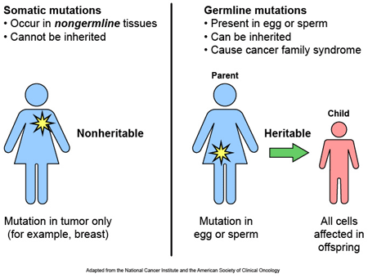
Exome sequencing detects mutations
http://www.stjude.org
Notes:
http://www.stjude.org/stjude/v/index.jsp?vgnextoid=5817b5b36e70c210VgnVCM1000001e0215acRCRD

Slide 15
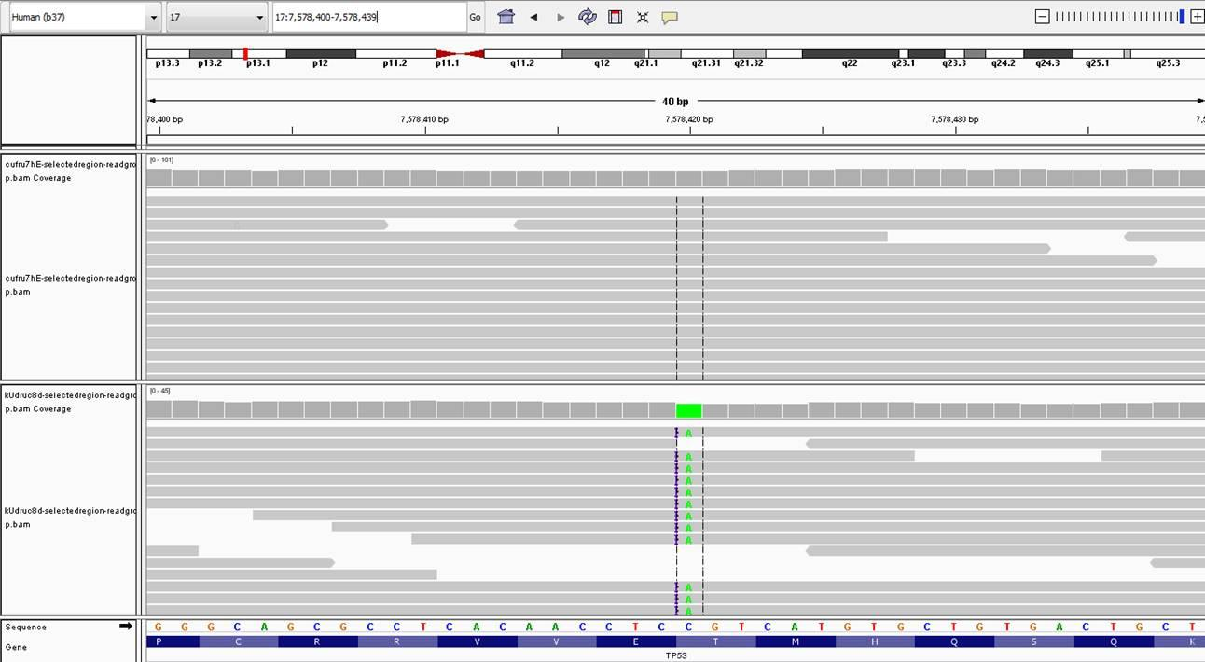
Somatic mutation calls require tumor-normal paired samples
normal
tumor

Slide 16
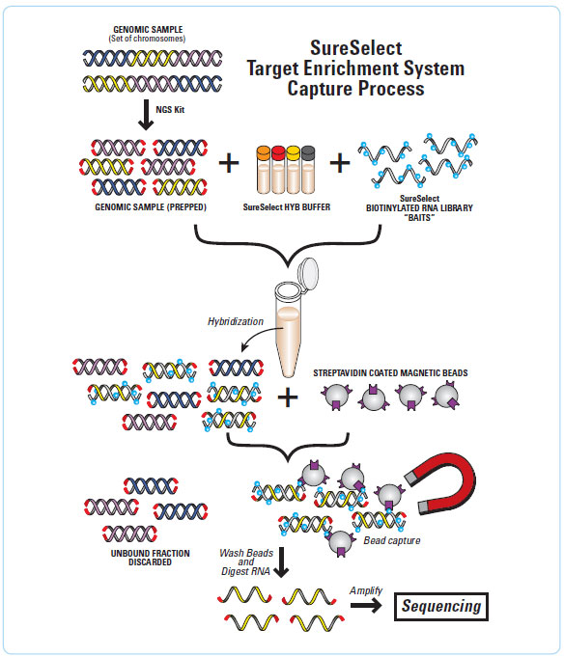
The SureSelect Target Enrichment workflow
http://www.genomics.agilent.com/article.jsp?pageId=3083
Notes:
SureSelect Target Enrichment Solutions allow you to target your research on the regions that matter most to you, whether analyzing the exome or focusing on a small targeted panel. Agilent has a solution to meet your needs. Agilent's SureSelect solutions for targeted DNA or RNA capture allow for you to increase sample throughput via multiplexing while achieving the sequencing depth required to accurately call SNPs, Indels and other mutations.
The SureSelect Target Enrichment workflow is solution-based system utilizing ultra-long – 120-mer – biotinylated cRNA baits – to capture regions of interest, enriching them out of a NGS genomic fragment library. Achieve your results faster with only one 24hr hybridization. Starting from gDNA, a shearing step produces small fragments
Prepare library with sequencer specific adaptors and indexes
Hybridize sample with biotinylated RNA library baits. Agilent uses ultra long 120mer RNA baits for the highest specificity.
Select targeted regions using magnetic streptavidin beads
Amplify and load on the sequencer

Slide 17
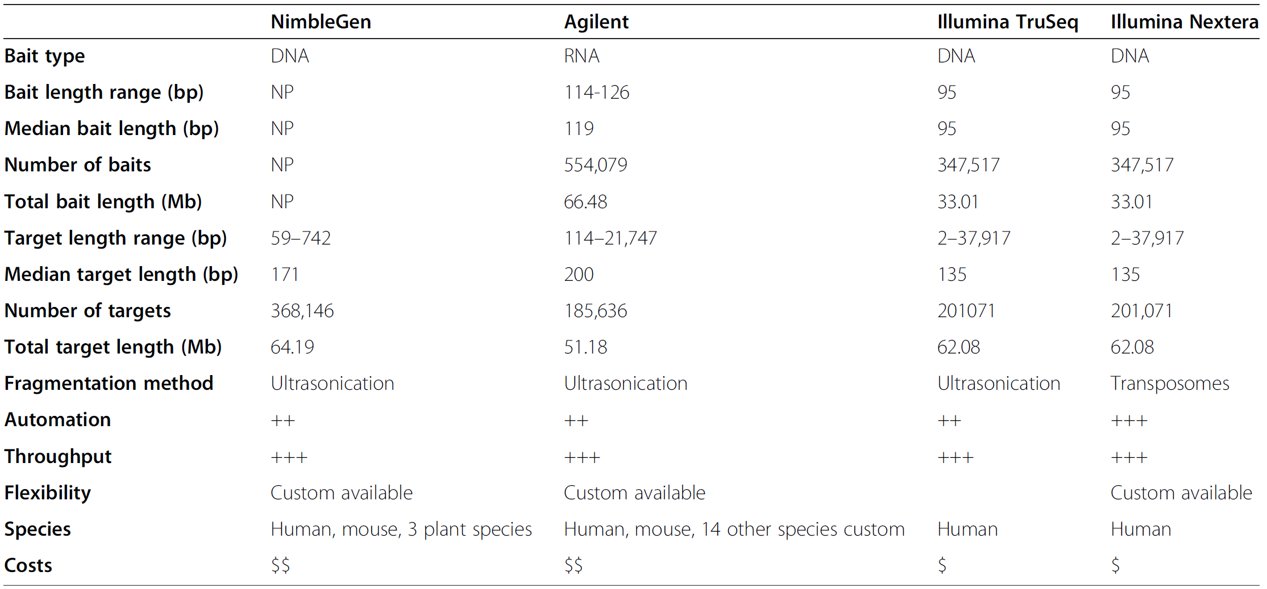
Comparison of four exome capture systems
Chilamakuri, C. et al. (2014) BMC Genomics. 15:449..
Notes:
Some NimbleGen information was not provided, indicated by NP. Relative automation and throughput indicated by “+” symbols, higher number of symbols
indicates easy to automate and higher throughput. Relative cost is indicated by “$” symbol, higher “$” symbols indicate the higher price.

Slide 18
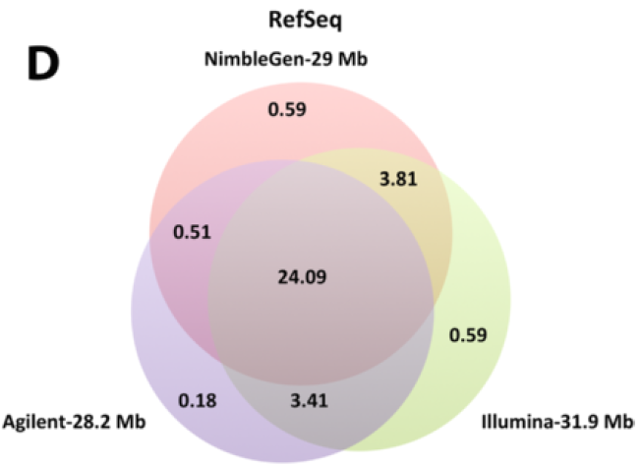
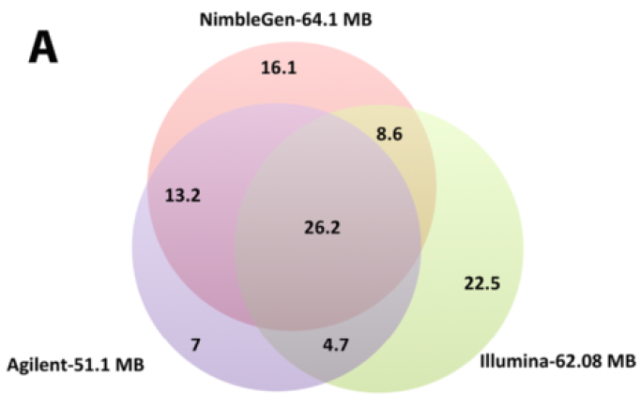
Coverage of exome capture systems
(33.3Mb coding exons)
Chilamakuri, C. et al. (2014) BMC Genomics. 15:449..
Notes:
Venn diagram showing the overlap between different features. A) Overlap among Agilent, NimbleGen and Illumina capture
targets. B) Overlap among RefSeq, CCDS, and ENSEMBL protein coding exon databases. Coverage of exome capture technology for C) CCDS
coding exons, D) RefSeq coding exons, E) ENSEMBL coding exons, and F) RefSeq UTRs.

Slide 19
Next generation sequencing (NGS)
Exome sequencing
Experimental design
Sample size
Sequencing coverage
Mutation study resource

Slide 20
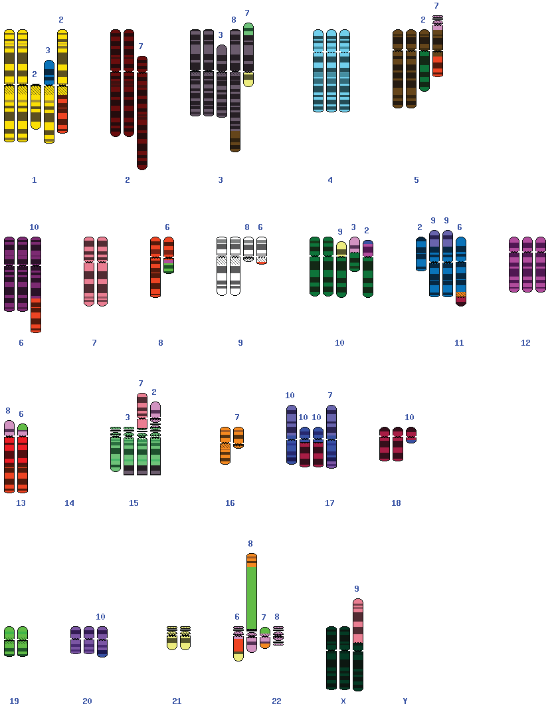
OVCAR-3, NCI60 cell line, Ovarian cancer
Complexity of the cancer genome
http://www.ncbi.nlm.nih.gov/projects/sky/skyquery.cgi

Slide 21
Whole exome DNA sources
Tumor DNA
Fresh frozen (FF)
Paraffin embedded tissue (FFPE)
Cell line
Xenograft
Normal tissue
Blood
Neighboring tissue
Clinical information
DOB
Date of diagnosis
Malignancy stage
Location of primary tumor
Location of metastatic tumor
Therapies

Slide 22
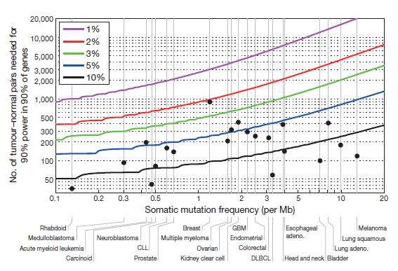
The Number of samples needed to detect significantly mutated genes
Lawrence, M.S. et al. (2014) Nature. 505(7484):495-501
Notes:
Figure 5 | Number of samples needed to detect significantly mutated genes,
as a function of a tumour type’s median background mutation frequency
and a cancer gene’s mutation rate above background. The number of
samples needed to achieve 90% power for 90% of genes (y axis). Grey vertical
lines indicate tumour type median background mutation frequencies (x axis).
Black dots indicate sample sizes in the current study. For most tumour
types, the current sample size is inadequate to reliably detect genes mutated
at 5% or less above background; see also Supplementary Fig. 9. Adeno.,
adenocarcinoma.

Slide 23
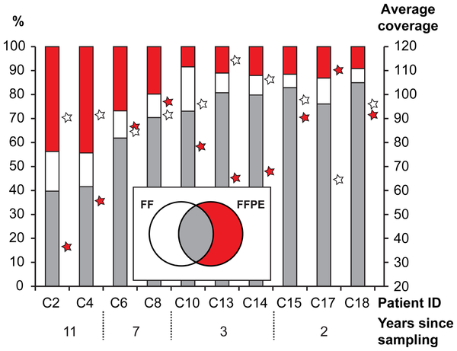
Variants detected in exome sequencing data from the paired FF/FFPE samples
Hedegaard, J. et al. (2014) PLoS ONE 9(5): e98187.
Notes:
Figure 2. Single nucleotide variants detected in DNA-Exome-
Seq data from the paired FF/FFPE samples. The percentage of
common (grey), exclusively FF (white) and exclusively FFPE (red) single
nucleotide variants are shown as bars referring to the left axis. The
average coverage is shown as stars for FF (white) and FFPE (red) on the
right axis. Patient ID and number of years of storage are shown below.

Slide 24
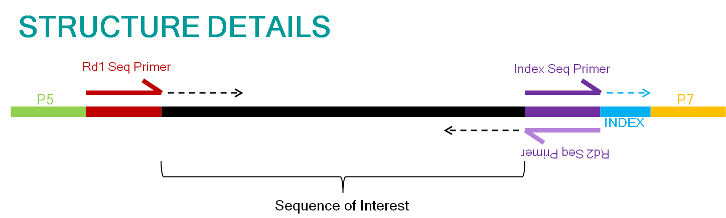
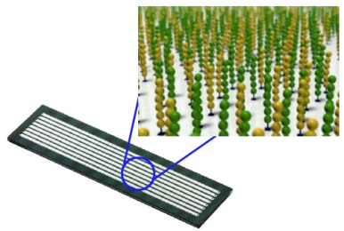
Sequencing terminology
1. Insert
2. Read
3. Single Read (SR)
4. Paired End (PE)
5. Multiplexing
6. Flowcell
7. Lane
Normand, R. et al. (2013) Methods Mol Biol. 1038:1-26.
Notes:
1. Insert —The DNA fragment that is used for sequencing.
2. Read—The part of the insert that is sequenced.
3. Single Read (SR)—A sequencing procedure by which the insert is sequenced from one end only.
4.Paired End (PE)—A sequencing procedure by which the inser t is sequenced from both ends.
5. Flowcell—A small glass chip on which the DNA fragments are
attached and sequenced. The flowcell is covered by probes that
allow hybridization of the adaptors that were ligated to the
DNA fragments.
6 Lane—The flowcell consists of eight physically separated channels called lanes. The sequencing is done in parallel on all
lanes.
7.Multiplexing/Demultiplexing —Sequencing a few samples on the same lane is called multiplexing. The separation of reads that were sequenced on one lane to different samples is called demultiplexing and is done by a script that recognizes the index of each read and compares it to the known indices of each
sample.
8. Pipeline —A series of computational processes
Normand R (2013) Methods Mol Biol. 1038:1-26.
http://nextgen.mgh.harvard.edu/IlluminaChemistry.html
http://www.giga.ulg.ac.be/jcms/prod_26859/illumina-genome-analyser-sequencing-technology-how-it-works
https://www.youtube.com/watch?feature=player_embedded&v=pfZp5Vgsbw0

Slide 25
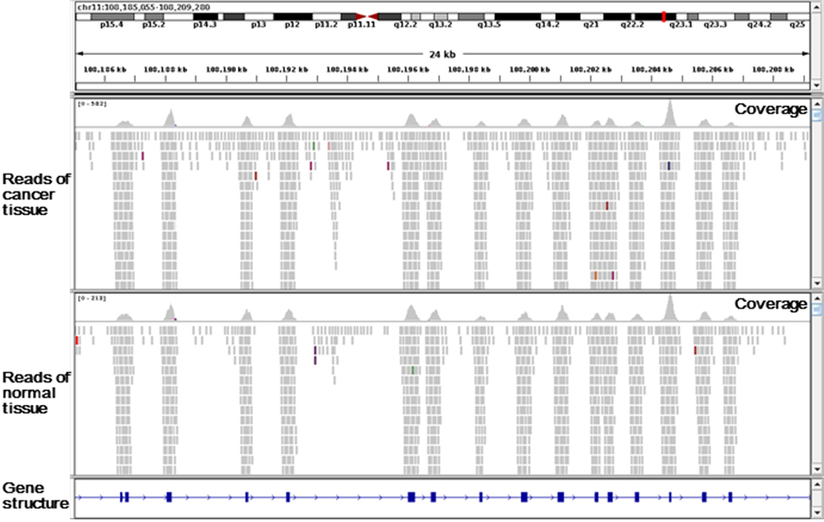
Sequencing Coverage
Average coverage =
read length * number of mapped reads/ genome size
Normand, R. et al. (2013) Methods Mol Biol. 1038:1-26.
Notes:
http://www.mc.pref.osaka.jp/omc2/en/category/gene.html
https://www.youtube.com/watch?feature=player_embedded&v=pfZp5Vgsbw0

Slide 26
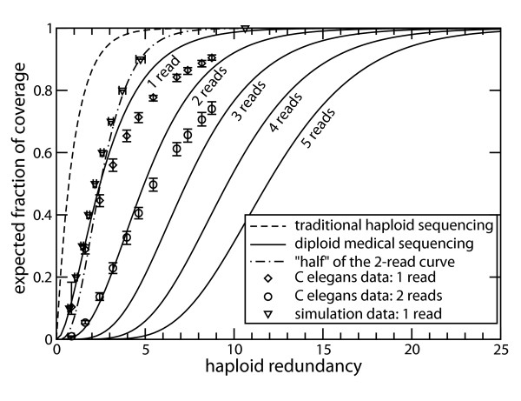
Diploid genome and coverage
Wendl, M.C. et al. (2008) BMC Bioinformatics. 9:239.
Notes:
Traditional haploid coverage model [15, 16] versus
diploid medical sequencing coverage results for minimum
number of covering reads φ ∈ {1, 2, 3, 4, 5}. The
figure also shows an additional curve that replots the diploid
φ = 2 curve, except where abscissa values are scaled by onehalf.
This aspect is relevant to the discussion of why the
redundancies for φ = 1 and φ = 2 do not differ by a factor of
two. Coverage progressions for φ ∈ {1, 2} are also shown for
the recent Illumina resequencing of C. elegans by Hillier et al.
[28]. These points represent average coverages over all
chromosome pairs, while their error bars show the observed
minima and maxima. Simulation data for φ = 1 on a 20 kb
fragment using 250 bp reads [20] are also shown. Points and
error bars represent the averages and extrema, respectively,
of 250 simulations.

Slide 27
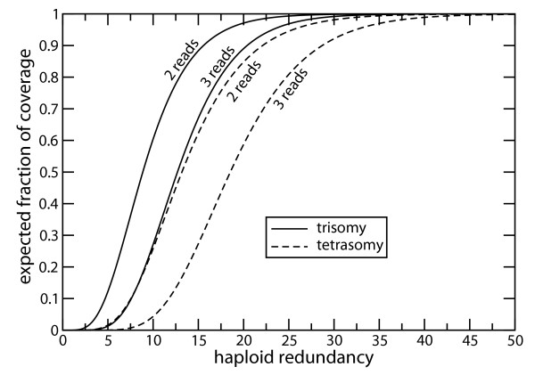
Polyploid genome and coverage
Wendl, M.C. et al. (2008) BMC Bioinformatics. 9:239.
Notes:
Fig. 4 shows expected coverage for trisomy
and tetrasomy for φ = 2 and φ = 3. Required depths
are clearly much higher than for diploid sequencing. For
example, we find redundancies of ρ = 42 and ρ = 57 for
trisomy and tetrasomy, respectively, when scaling to 10×
BAC sequencing at the level of φ = 2.

Slide 28
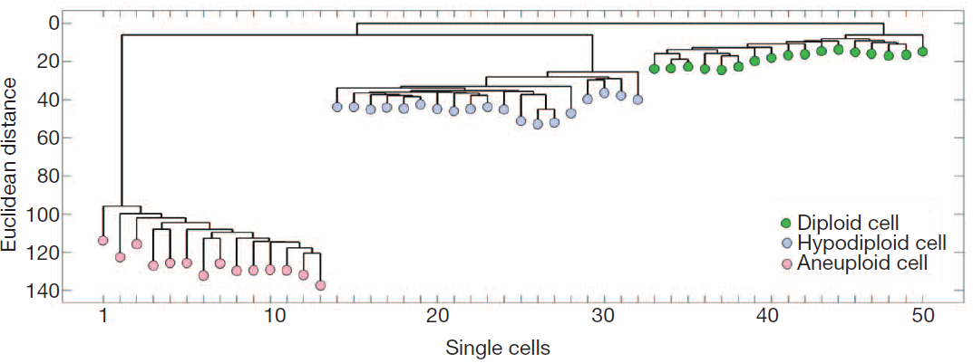
Single cell exome sequencing demonstrates the sample heterogeneity
Triple-negative breast cancer (TNBC)
Wang, Y. et al. (2014) Nature. 512(7513):155-60.
Notes:
Figure 3 | Single cell and population sequencing of a triple-negative breast
cancer. a, Frozen TNBC specimen. b, Circos plot of mutations and CNAs
detected by population sequencing of theTNBC, with cancer genes on the outer
ring. c, Flow-sorting histogram of ploidy distributions, showing three major
subpopulations: diploid (D), hypodiploid (H) and aneuploid (A).
d, Neighbour-joining tree of 50 single cell integer copy number profiles, rooted
by the diploid node. e, Clustered heatmap of the nonsynonymous point
mutations detected by single nuclei exome sequencing and population
sequencing (P). Mutations detected in one cell are excluded.

Slide 29
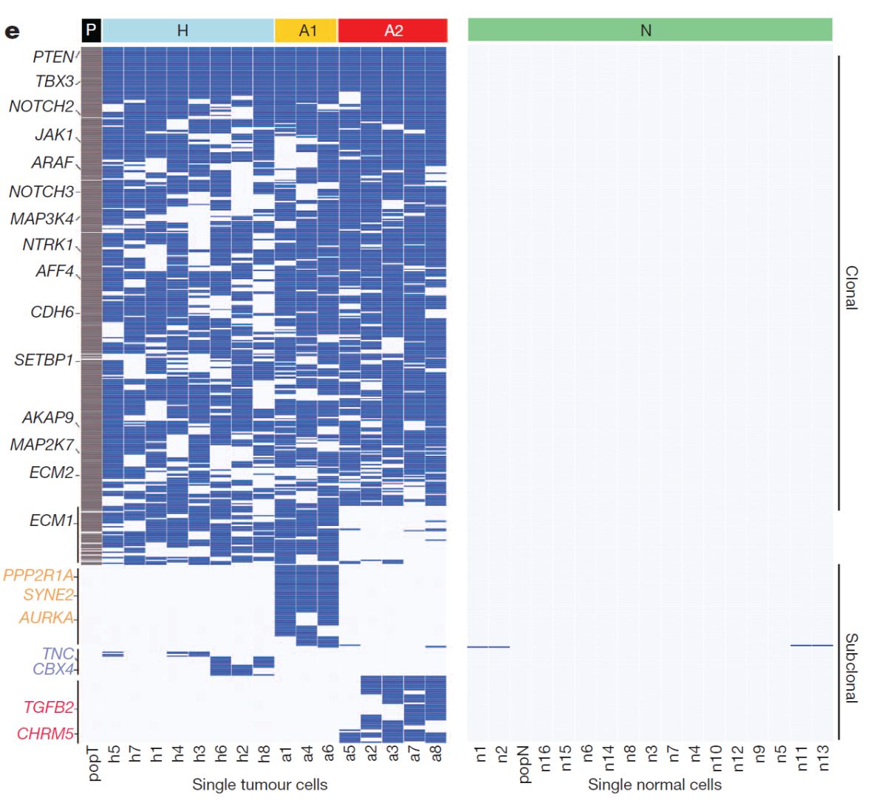
Certain mutations only occur in a subset of TNBC cell populations
Wang, Y. et al. (2014) Nature. 512(7513):155-60.
Notes:
Figure 3 | Single cell and population sequencing of a triple-negative breast
cancer. a, Frozen TNBC specimen. b, Circos plot of mutations and CNAs
detected by population sequencing of theTNBC, with cancer genes on the outer
ring. c, Flow-sorting histogram of ploidy distributions, showing three major
subpopulations: diploid (D), hypodiploid (H) and aneuploid (A).
d, Neighbour-joining tree of 50 single cell integer copy number profiles, rooted
by the diploid node. e, Clustered heatmap of the nonsynonymous point
mutations detected by single nuclei exome sequencing and population
sequencing (P). Mutations detected in one cell are excluded.
Sequence reads
in FASTQ format were mapped to the human assembly US National Center
for Biotechnology Information (NCBI) build 36 (hg18) using the Burrows-
Wheeler alignment tool42 (BWA version 0.6.0) with default parameters
Single nucleotide variant detection. The GATK UnifiedGenotyper was used to
detect single nucleotide variants (SNVs)44. All single cells and population samples
were processed together to generate a single VCF4 file. Variants detected in the
matched normal samples from the ER1 and TNBC were filtered from the somatic
variants to eliminate germline mutations using matched normal tissue samples,
the diploid fraction and the normal single cells.

Slide 30
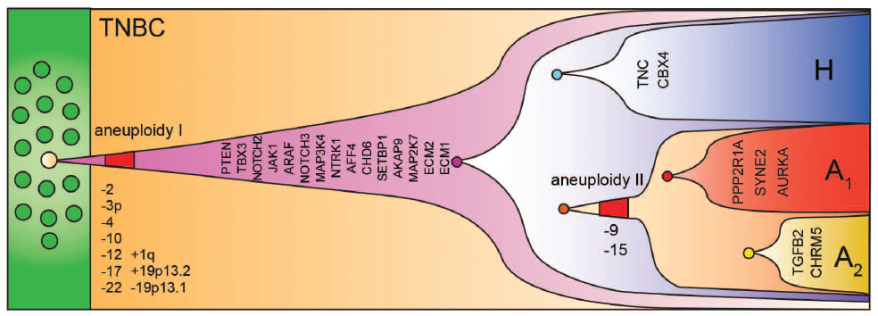
Clonal evolution in the TNBC inferred from single cell exome and copy number data
Wang, Y. et al. (2014) Nature. 512(7513):155-60.
Notes:
Extended Data Figure 6 Clonal evolution in the TNBC inferred from single cell exome
and copy number data.

Slide 31
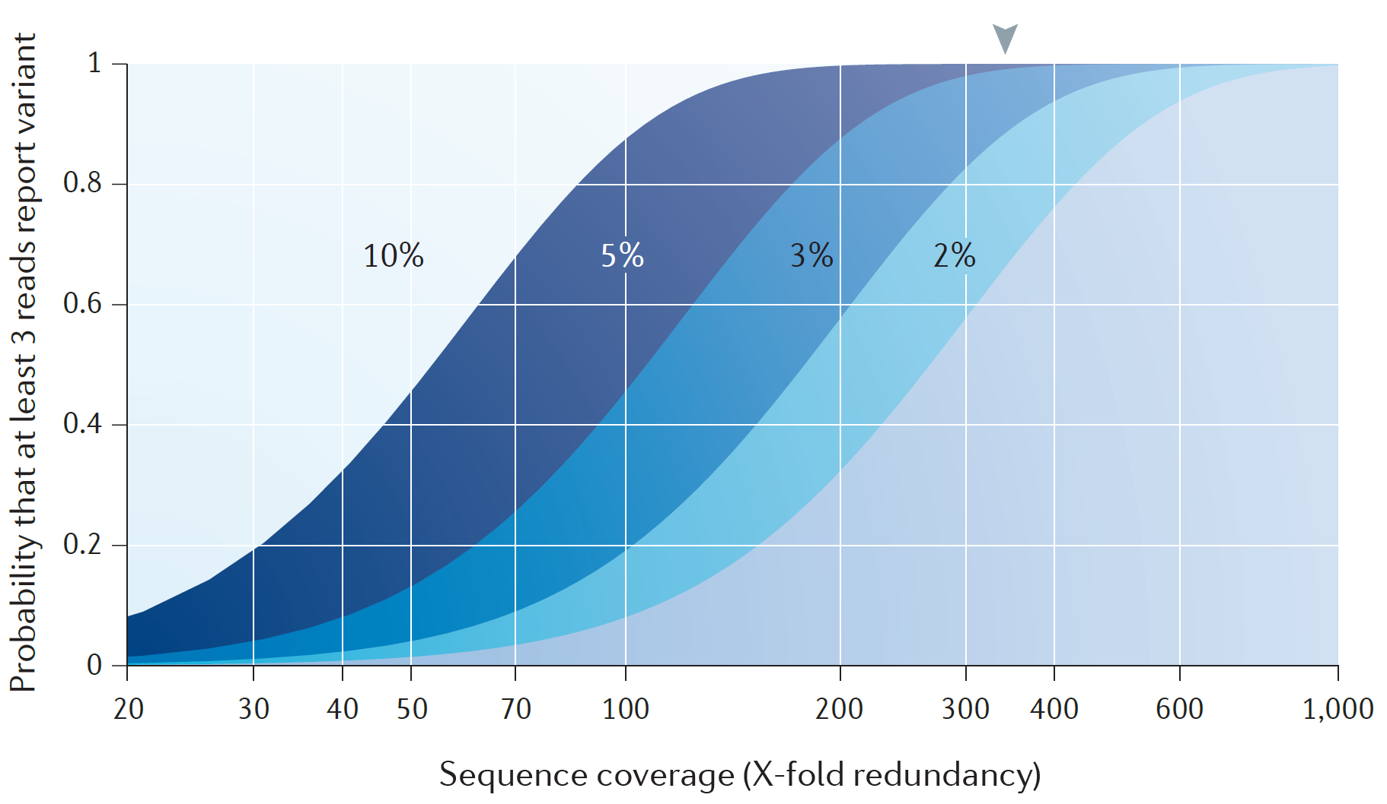
High coverage is needed for low tumor fraction samples.
Ding, L. et al. (2014) Nat Rev Genet. 15(8):556-70
Notes:
Early sequencing projects were based on the Lander–Waterman theory156 for haploid
coverage, which recommended a redundancy factor (ρ) of ~10X. Disregarding biases,
this implies that loci are spanned by an average of 10 sequence reads and that >99.99%
of the genome is represented by the data156. However, for medical applications, both
alleles must be reliably identified. The identification of a single-nucleotide variant (SNV)
requires its observation in multiple reads (usually at least three), and the accrual of these
reads is determined by the random dynamics of sampling and coverage quantified in the
ideal case (that is, pure samples, perfect data and no sequence bias). If the minimum
condition is ≥3 spanning reads per allele, a figure of ρ ≈ 30X is then required to attain
approximately the same 99.99% standard157. This has been the de facto redundancy for
cancer sequencing projects with respect to detecting SNVs, although it does not apply
to other types of events. For example, the presence of insertions and deletions (indels) is
suggested whenever the reference-aligned average length of spanning fragments is
significantly different from the average fragment length of the originating library52. It is
tricky to apply this principle49,158 because a genuine event has to be distinguished from
cases in which predominantly shorter or longer fragments were sampled merely by
chance. At 30X, the size range of insertions for which indels can be detected with low
type I error is narrow, which suggests that more data are needed159. There are even
greater data requirements if somatic mutational events within subclones of a tumour
are to be identified. For a subclone with a mass that is a fraction μ of that of the total
tumour, the probability of at least 3 reads reporting a heterozygous variant is
P = 1 – e–R (1 + R + R2/2), where R = μρ/2. In a 5% mass subclone, the remarkable figure of
340X data is required if 99% of subclonal variants have to meet the detection conditions
(see the figure). Smaller subclones require even more data and readily reach 500X in
certain instances. The biomedical relevance of subclones and the growing throughput
of instruments mean that the amount of data generated for cancer genomic projects
will continue to increase.

Slide 32
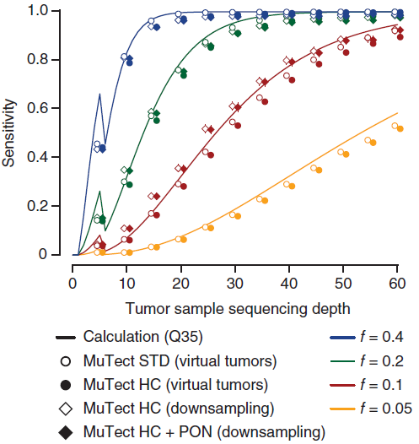
Mutation detection sensitivity as a function of sequencing depth and allelic fraction
Cibulskis, K. et al. (2013) Nat Biotechnol. 31(3):213-9.
Notes:
The virtual-tumor approach begins with deep-coverage data from a high-coverage, whole-genome sample (NA12878) sequenced on Illumina HiSeq instruments: two libraries⁴², 'Solexa-18483' and 'Solexa-18484', at 30× each and one library⁴³, 'Solexa-23661', at 30×. These data are publicly available; details are available in Supplementary Table 5.

Slide 33
Steps to Bring in Projects to CCR–SF
Make sure to consult your bioinformatics for experiment design
https://ostr.cancer.gov/sequence/request
Courtesy of Yongmei Zhao, CCR-SF
Notes:
http://ncifrederick.cancer.gov/rtp/csas/requestor/help.asp
Shared Services Help
Welcome to the Accessions System. Overview: The ATP/LASP Accessions System (or CSAS) was created to provide investigators and core service personnel with an automated means of placing, reviewing, and tracking requests made for ATP and LASP-Pathology/Histotechnology Laboratory support at The Frederick National Laboratory.
Each request for service at the Frederick National Lab is carefully tracked and reviewed. At any time the requestor may view the current disposition of their requests using this system.
Determining the Appropriate Service Area: Investigators who are not familiar with the Frederick National Lab may have difficulty choosing the appropriate Core Service when placing a new request. The Frederick National Lab Advanced Technology Program and LASP-Pathology/Histotechnology Laboratory websites provide an overview of each Core Service program and the services they offer. In addition, requestors can contact the office of the Program Administrator, Advanced Technology Program for further assistance.
Help Using the Online Accessions System: Requestors can contact the Frederick Webmaster for assistance using the online accessions system.
Service Request Submission Guide for the Frederick National Laboratory, Laboratory Animal Science Program (LASP) and Advanced Technology Program (ATP)
Go to the Accession System web site: http://ncifrederick.cancer.gov/rtp/csas/requestor/default.asp.
At the Accession System web site choose from either "I have used this system before" or "I am a new user" and follow the directions. Your description of the work to be performed can be based on discussions with your ATP or LASP laboratory point of contact.
If you have used the system before but have forgotten your password, go to the "I forgot my password" option on the left of the web page. Enter the information requested. You will receive an e-mail containing your password.
Be sure to select the appropriate ATP or LASP service. When you submit your request, an e-mail is sent to that service. You must enter the e-mail address of your administrative officer or approving official (AO), who has fiscal authority to review your budget.
If you believe you qualify for partial Frederick National Lab Office of the Director Research Support (ODRS) Program funding, you can check the ODRS funding request box at this point. If you choose this funding option, you should also indicate whether or not you are a member of CCR. Criteria for ODRS funding can be found at http://ncifrederick.cancer.gov/rtp/csas/requestor/ODRSFunding-Guidance.pdf.
The ATP or LASP service that you have identified will prepare a cost estimate and enter it into the system. The system then sends you an e-mail that details this cost information.
Upon receiving a cost estimate, return to the Accession System web site and either accept or reject it.
If you accept the cost estimate, the system will send an e-mail to Frederick National Lab OD for scope review by the Assistant Project Officers for ATP or LASP, respectively.
Following scope approval, your AO will need to approve the expenditure (100% of the cost estimate if ODRS funding is not requested) by e-mail. For ATP-specific ODRS requests, the system will also solicit approval from OD (if non-CCR, Assistant Project Officer for ATP) or CCR (Associate Director, OSTR). All LASP-specific ODRS requests also need approval from OD (Assistant Project Officer for LASP). ODRS funding may be granted for up to 50% of the cost estimate, or possibly more with ATP-specific requests from CCR investigators.
Upon approval, the system will notify the appropriate ATP/LASP service and work on your pilot project will begin. If disallowed, please follow up with your AO, or OD, or CCR (see #8 above) if ODRS funding was requested, before reengaging the ATP/LASP.
If you encounter any difficulties, please call your point of contact for ATP, Melissa Castle (301-228-4678), or LASP, Wayne Christensen (301-846-1567) for advice on how to proceed.

Slide 34
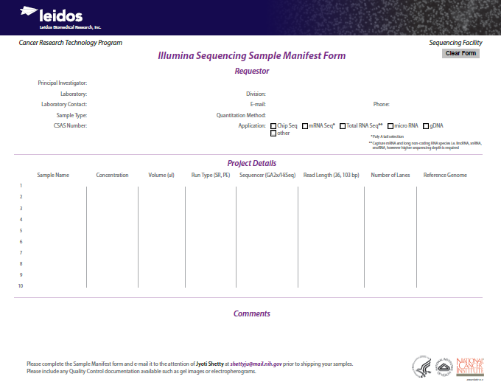

Slide 35
Next generation sequencing (NGS)
Exome sequencing
Experimental design
Mutation study resources
Genome in a Bottle
DREAM mutation challenge

Slide 36

Genome in a Bottle Consortium
No widely accepted set of metrics to characterize the fidelity of variant calls from NGS…
Genome in a Bottle Consortium is developing standards to address this…
well-characterized human genomes as Reference Materials (RMs)
characterized and disseminated by NIST
tools and methods to use these RMs
Global Alliance for Genomics and Health Benchmarking Team
http://genomeinabottle.org

Slide 37
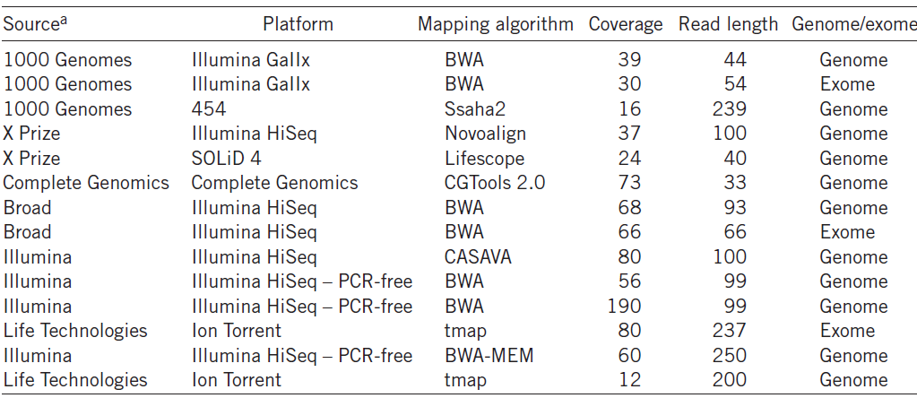
The data sets for NA12878 are available at the Genome in a Bottle ftp site at NCBI
ftp://ftp-trace.ncbi.nih.gov/giab/ftp/data/NA12878
Zook, J.M. et al. (2014) Nat Biotechnol. 32(3):246-51.
Notes:
Table 1 Description of data sets and their processing to produce bam files for our integration methods
These data and other data sets for NA12878 are available at the Genome in a Bottle ftp site at NCBI (ftp://ftp-trace.ncbi.nih.gov/giab/ftp/data/NA12878/) and are described on a spreadsheet at http://genomeinabottle.org/blog-entry/existing-and-future-na12878-datasets.

Slide 38
Integration Methods to Establish Benchmark Variant Calls
Candidate variants
Arbitrate using evidence of bias
Concordant variants
Find characteristics of bias
Confidence Level
Zook, JM et al (2014) Nat Biotechnol. 32(3):246-51.
http://www.slideshare.net/GenomeInABottle/presentations

Slide 39
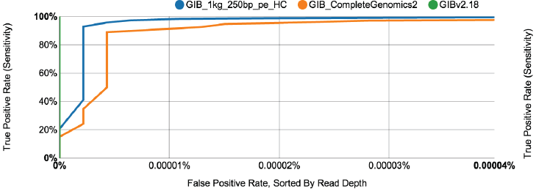
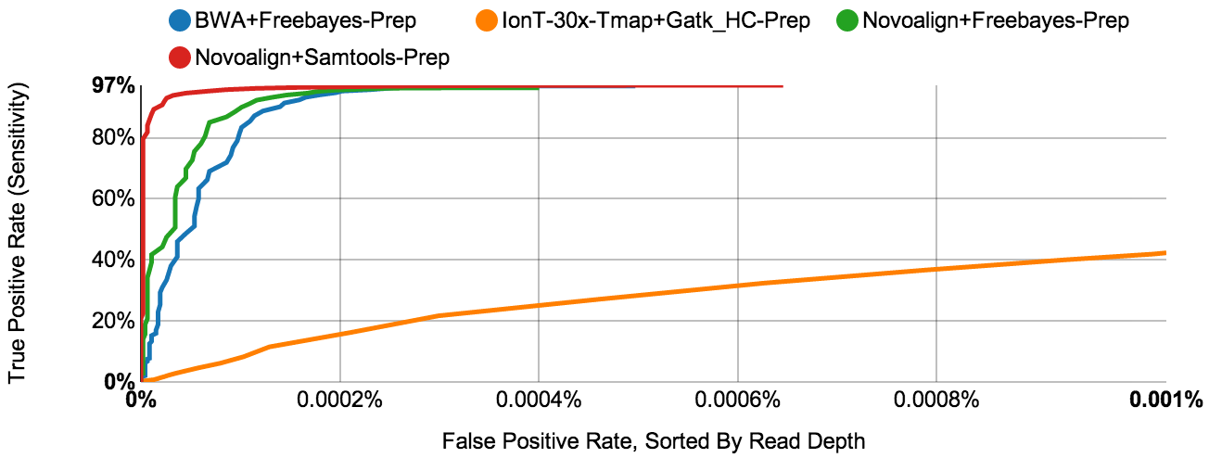
~2.7M high confident snps are detected by multiple algorithms
Exome SNPs
Exome SNPs
Zook, J.M. et al. (2014) Nat Biotechnol. 32(3):246-51.
Notes:
Supplementary figure 31. Precision Rate (TP/(TP+FP)), Sensitivity (TP/(TP+FN)), and Specificity (TN/(TN+FP)) for
Each data set using our integrated genotypes as a benchmark. False positive rate = FP/(FP+TN)
Supplementary Figure 31: Performance assessment of exome SNPs for the datasets in
Supplementary Figure 4 using our integrated genotypes as a benchmark, excluding uncertain regions
including structural variants in dbVar. The top tables summarize overlap of individual datasets
with our integrated genotypes. In the last 4 columns, the genotype of the individual dataset is
before the dash, and the genotype of our integrated calls is after the dash. The bar graphs depict
the Precision Rate (TP/(TP+FP)), Sensitivity (TP/(TP+FN)), and Specificity (TN/(TN+FP)) for each
dataset using our integrated genotypes as a benchmark. Finally, Receiver Operating Characteristic
(ROC) curves plotting True Positive Rate vs. False Positive
Rate are shown sorted by Read Depth (top) or Variant Quality (bottom).

Slide 40
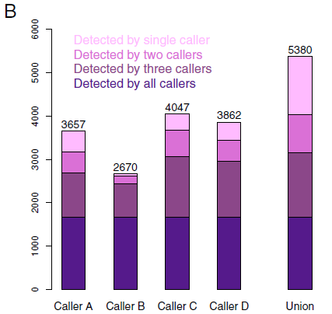
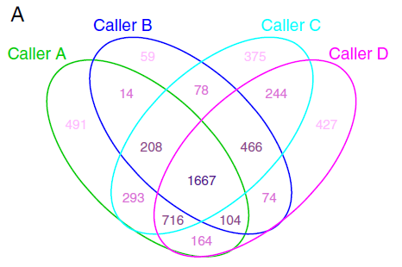
The mutation caller performance varies drastically
16 LUSC tumor-normal exome-seq pairs
Kim, S.Y., Speed, T.P. (2013) BMC Bioinformatics. 10;14:189.
Notes:
16 lung cancer exome and second depth sequencing

Slide 41
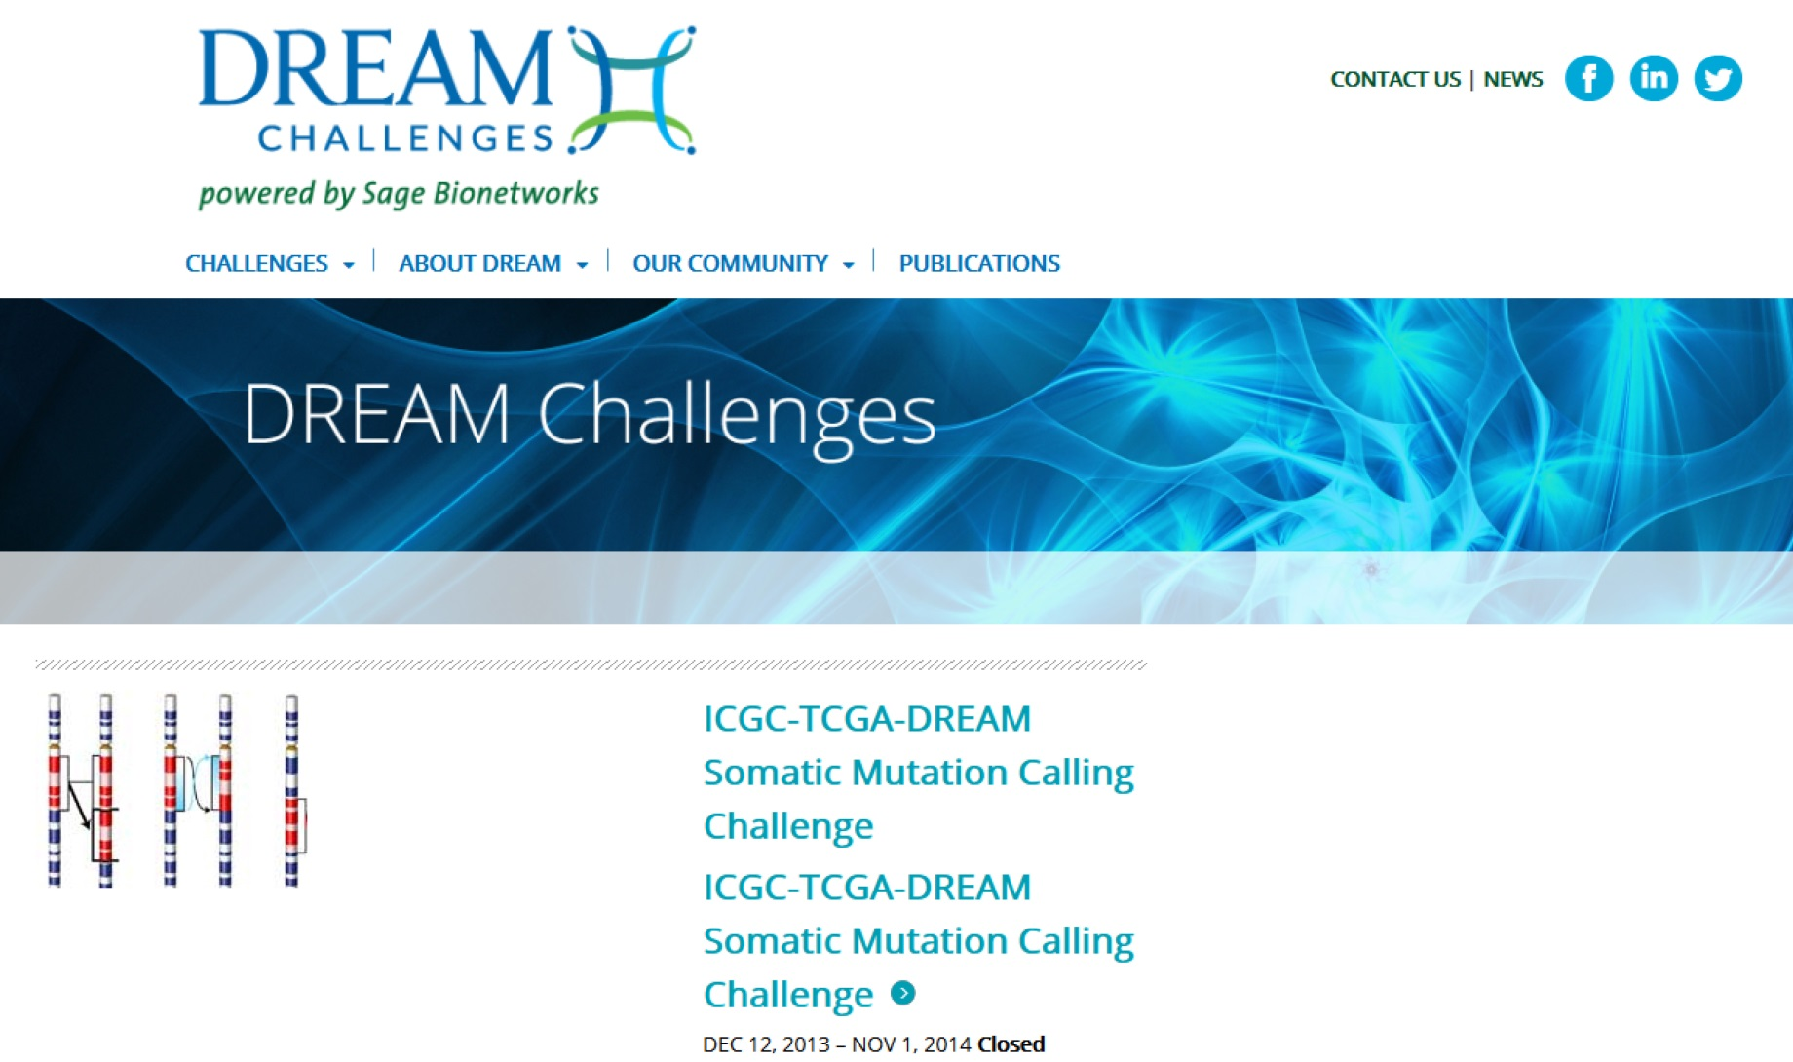

http://dreamchallenges.org/

Slide 42
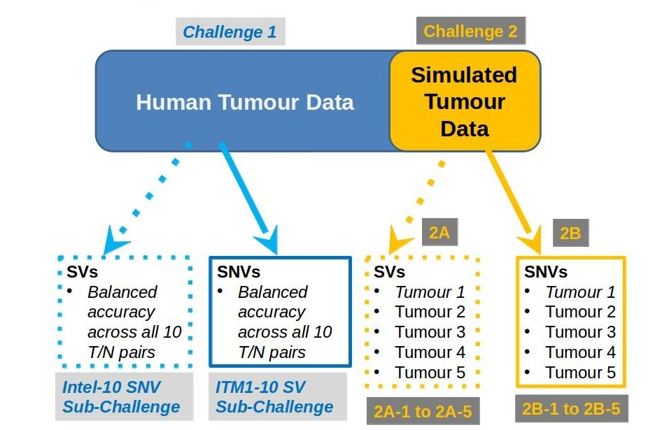
Challenge Data and Assessment
http://dreamchallenges.org/

Slide 43
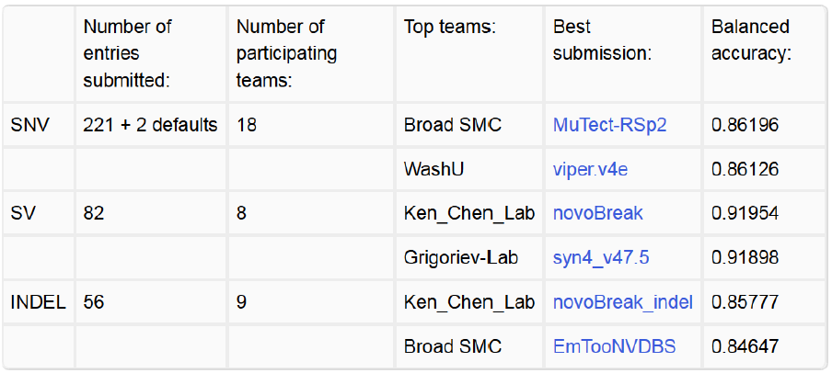
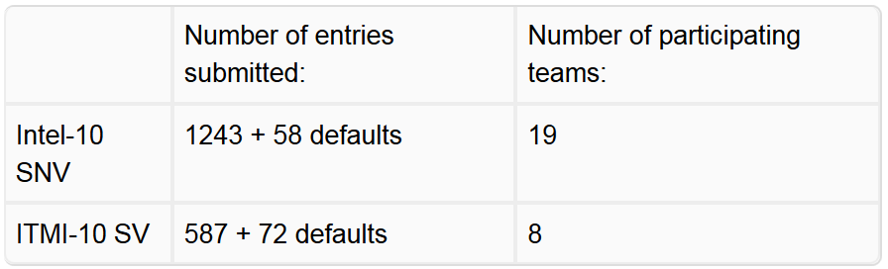
In silico challenge #4 (SEPT, 2014)
Tumor sample data, early 2015.
http://dreamchallenges.org/

Slide 44
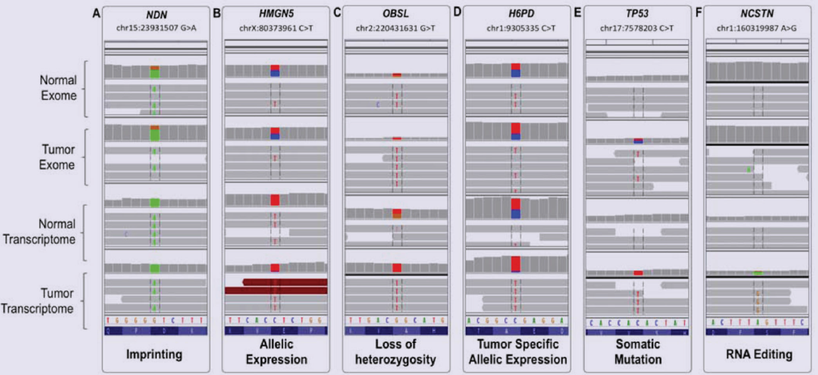
What can we learn from exome sequencing
Mudvari, P. et al. (2013) J Metabolomics Syst Biol. 1(1). pii: 7.
Notes:
Integrative Genomics Viewer (IGV) representation of examples of SNP calls aligned between the four analyzed datasets:
Normal Exome, Tumor Exome, Normal Transcriptome, and Tumor Transcriptome. (A) G>A substitution on chr15:23931507 in
NDN, representing imprinting: the variant nucleotide (A) is in heterozygote state in the exomes and in homozygote in the
transcriptomes. (B) C>T substitution on chrX:80373961in HMGN5, representing strong allelic expression from the variant allele
in both transcriptomes. (C) G>T onchr2:220431631 in OBSL1, representing LOH: the SNP is heterozygote in the normal exome
and transcriptome, and homozygote in the tumor exome and transcriptome. (D) C>T onchr1:9305335 in H6PD, representing
tumor specific allelic expression: the SNP is heterozygote in the exomes and normal transcriptome, and, homozygote in the
tumor transcriptome. (E) C>T onchr17:7578203 in TP53 representing somatic mutation, likely driving: the variant is not present
in the normal exome and transcriptome, and transitions from hetero- to homozygote from the tumor exome to tumor
transcriptome. (F) A>G on chr1:160319987 in NCSTN representing RNA editing – the variant is not present in the exomes; it
appears in the tumor transcriptome only, suggesting potential tumor specific editing mechanism.
Mudvari et al. Page 12
J Metabolomics
The inferred insert size can be used to detect structural variants, such as:
deletions
insertions
inter-chromosomal rearrangements
IGV uses color coding to flag anomalous insert sizes. When you select Color alignments>by insert size in the popup menu, the default coloring scheme is:
Red color: for an inferred insert size that is larger than expected (deletion)
Blue color: for an inferred insert size that is smaller than expected (insertion)
http://www.broadinstitute.org/igv/interpreting_insert_size
A: green; C: Blue; T: red; G:orange

